Slide 1

Trawell
Presented By Group 4

Slide 2
Summary
With Trawell adventure awaits
With Trawell all you need is desire to explore
Just be ready, we'll take you there

Slide 3


Problem statement & Solution
Despite the number of travel apps available online and a million blogs that talk about how to travel smartly, people still struggle to organize their own trips and find activities that suit their interests.
Here at TRAWELL we take care of all your travel​ needs
We make sure that users go through seamless process for managing his/her travel

Slide 4
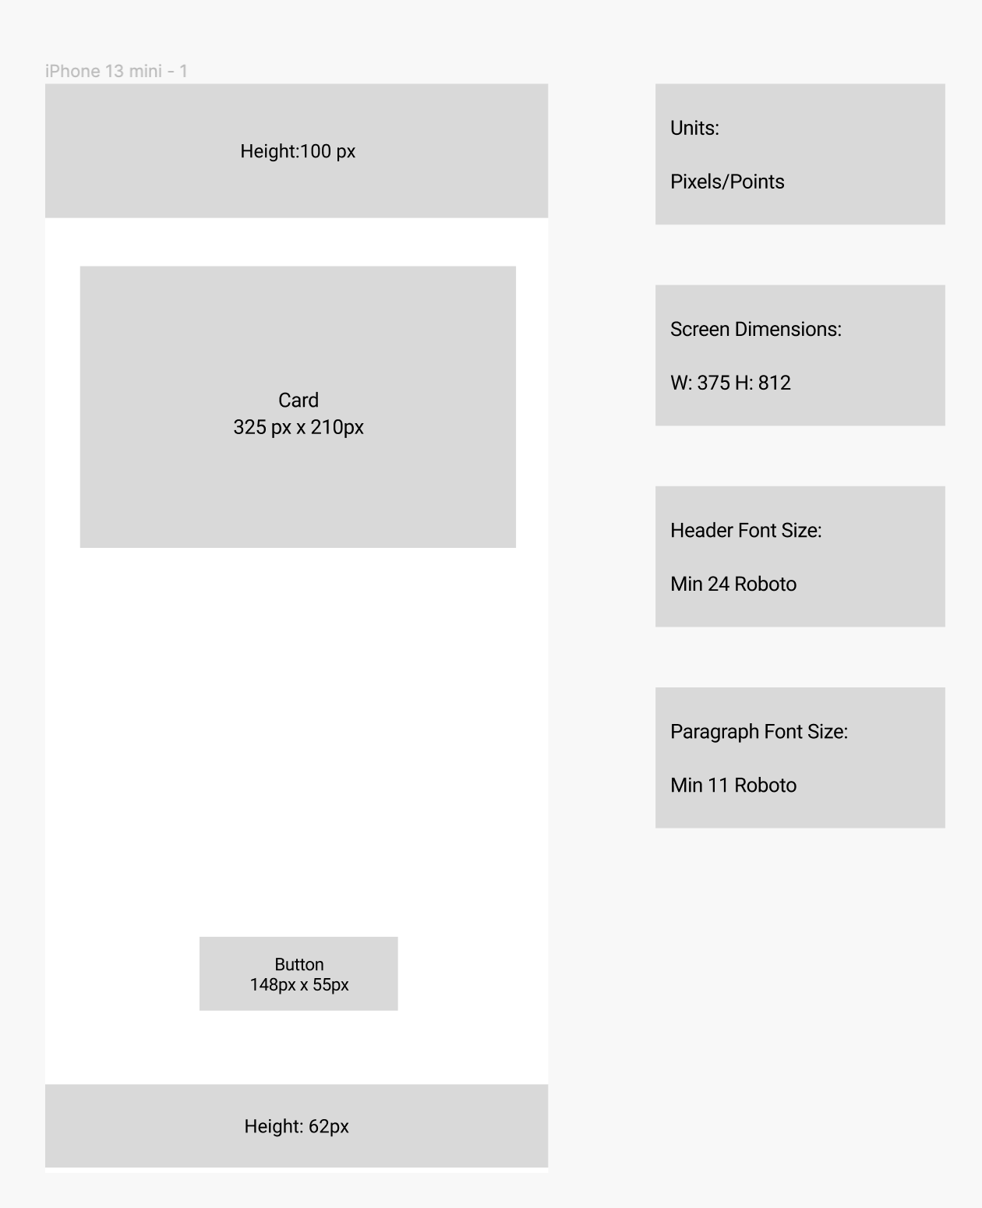

Slide 5
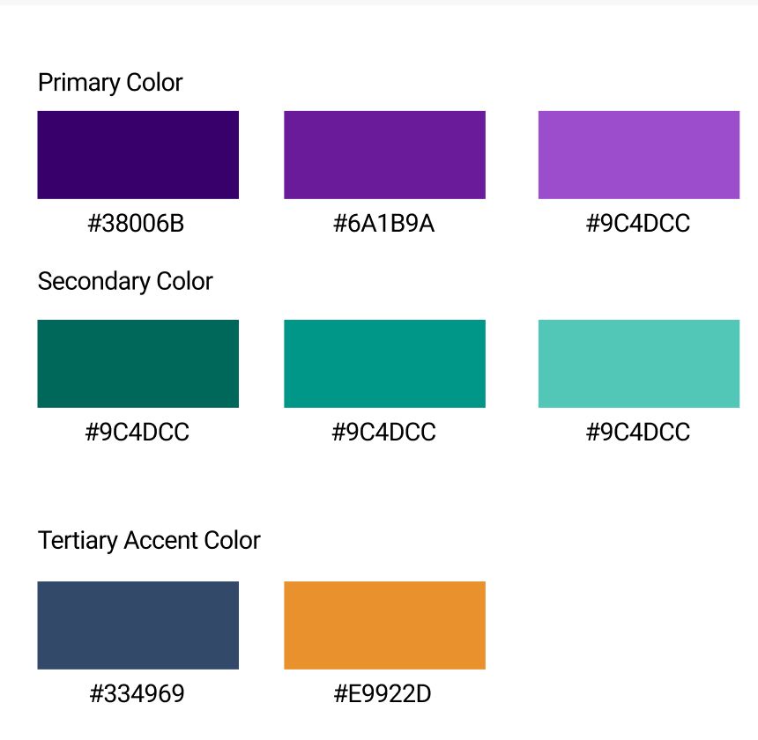
Color Palette & Typography
Typography:
Buttons:
Primary: Roboto 18 Regular
Secondary: Roboto 14 Regular
Tertiary: Roboto 14 Italic Regular
Heading:
Primary: Poppins 34 Medium
Secondary: Poppins 20 Medium
Tertiary: Poppins 16 Medium
Text:
Poppins 13 Light

Slide 6


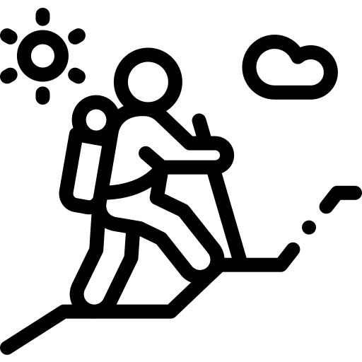

Product Objectives
Provide individual bookings for renting cars, booking train and flight tickets
Create recommended destinations depending on season
Create
adventurous experience and remove hassles
Provide simple user Interface to customers

Slide 7




Product Objectives – Cont'd
Provide simple registration process for consumers
Collect feedback from customers to improve application
Give special all in one - overall packages
Provide Preplanned trips in single itinerary

Slide 8


Product Objectives – Cont'd
Guide options to aid Customer in their Travel
24X7 Customer Support

Slide 9



Target Audience
Age group between 18-45 years are mainly focused with a tremendous and adventurous trip experience
Application always works and rely on the customer satisfaction and comfort, mainly working professionals gets lots of benefit just selecting the holiday package instead of stressing out in planning a trip
Confused customers are benefited by holiday recommendation service which ease them in selecting the vacation spot

Slide 10




USER SEGMENTATION
Age Group – 16 to 60 years
Psychographics – Fear of paying more to agents for trips
Demographics – Includes people from cities mainly 9:00 – 6:00 work force with busy lives.
Technology Orientation - The level of users’ tech savviness.

Slide 11



User needs
A high-quality mobile application with many features
A perfect holiday package
Collect feedback about the website
User-friendly travel application

Slide 12



User needs
Take reviews of the Tourist places
24 X 7 customer support to the users
Enhanced trust, privacy, and transparency
Offline maps to guide users in absence of internet

Slide 13




User needs
Multi language support
Coupons and discounts to the users
Surveys on customer satisfaction
Adding customer voice with ratings & reviews.

Slide 14
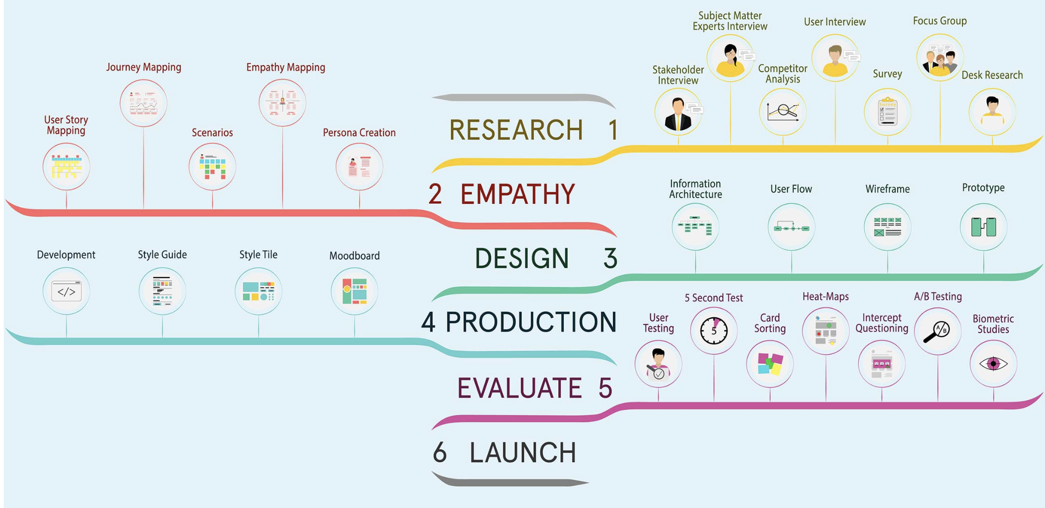
Design Process – Key Phases
Notes:
I’m Achyuth, so let me just continue with the Design Process that we have implemented. My team and I have followed these 6 steps to develop the High Fidelity design

Slide 15
Ux research methods USED
User interview
Surveys
Personas Building
Concept testing
Notes:
Next, comes the UX Research Methods that we have used: User Interview, Surveys, Personas Building and Concept Testing

Slide 16
Ux research method – User Interview
Conducted 1-1 interviews with users to better understand their needs and frustrations when it comes to browsing travel websites
Age: 25–47
Number of participants: 4
Method of Interview: We conducted interviews through zoom and in-person setting
Notes:
Coming to the User Interview, we have conducted One on One interview with 4 participants from age 25-47

Slide 17
Ux research method – User Interview Continued
Questions used for interview :-
How often do you travel?
Familiarity with travel apps and websites
Time spent on the booking websites
Biggest obstacle to plan a trip
Concerns when travelling
What you prefer to do during the trip?
Notes:
Most of the questions fall under these category and we could have come up with

Slide 18
Ux research method – User Interview Continued
Key Takeaways from Interview:-
When planning for a trip, participants find information's scattered.
Participants were interested in viewing unique travel options, travel packages, and transportation.
All participants like to view deals, promotions, and exclusive pricing availability for their bookings.
Traveling in groups was a priority for participants.
Personalized trip plans make a better travel experience as per the participants
Notes:
These are the key takeaways from the interview which do represent the key pain points that the participants were facing before. This is absolutely necessary for us to solve the challenges that the users were facing before

Slide 19
Ux research method – Survey
Conducted a survey using uxtweak to understand the users needs, likes and dislikes when planning and booking travel online
Age: 25–47
Number of participants: 7
Notes:
Coming to surveys, we have used the tool called UX Tweak to distribute it to other set of participants and gathered the results which we will come up soon later

Slide 20
Ux research method – Survey Continued
Questions used for interview :-
What is your age?
When booking travel online, do you prefer to book using mobile app or desktop app?
How often do you travel?
What is the main reason you book vacation ?
Notes:
These were the basic questions that we asked: Like the age, preference, frequency and the typical reasons for booking the vacation

Slide 21

Ux research method – Survey Continued
Study Link :-
https://app.uxtweak.com/questionnaire/results/OVE84z1LepWDkr6ibPKBw/F9l7IERilJ1fh42KVQtgh

Slide 22
Ux research method – Persona Building
Collect
Collect the information about targeted users.
Identify
Identify behavioral patterns from research data
Create
Create personas and prioritize them
Find
Find scenario(s) of interaction & create user personas UX documentation
Share
Share your findings and obtain acceptance from the team

Slide 23
Ux research – Concept Testing
The idea was implemented, and responses received were documented
It helped us jot down the requirements needed to move forward with the prototyping
We spoke to a group of individuals and understood the most essential functionalities needed
It helped us gain insight into whether customers understood the idea and would want to use product
We conducted this to collect feedback from the user on our idea in the early stages

Slide 24
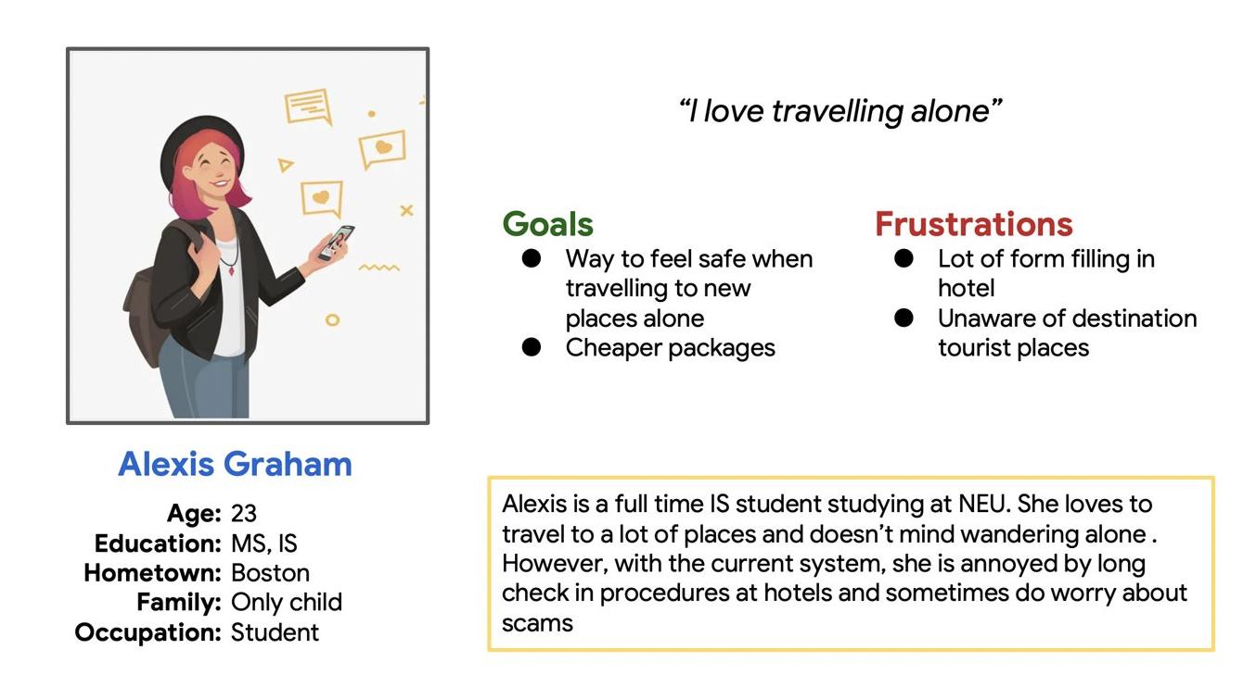
Personas 1

Slide 25
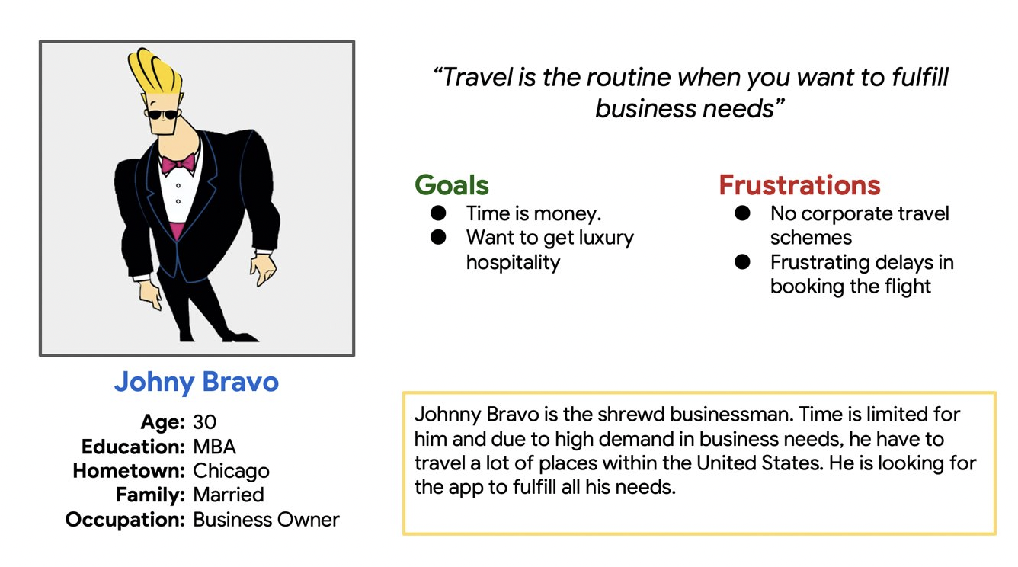
Personas 2

Slide 26
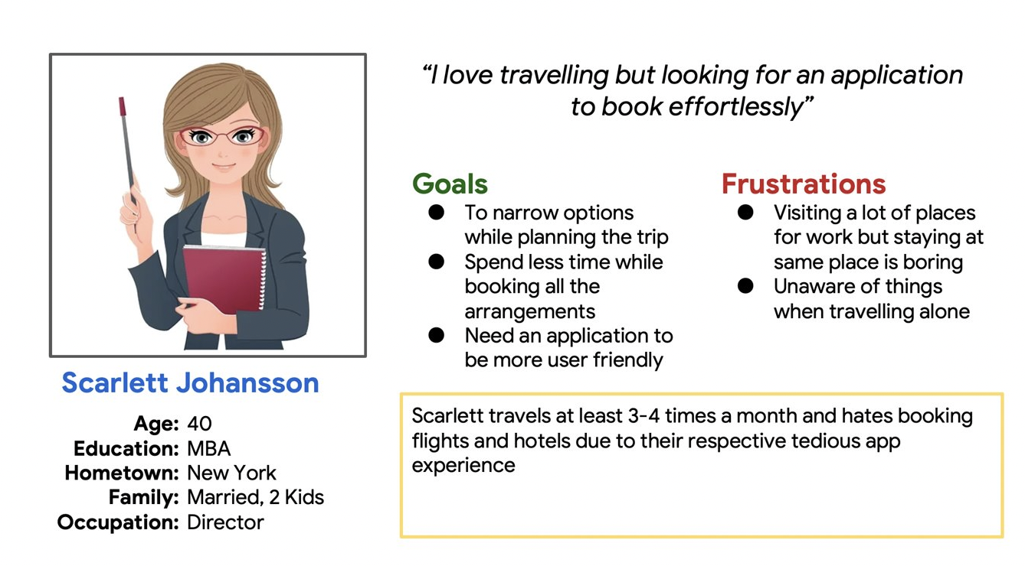
Personas 3

Slide 27
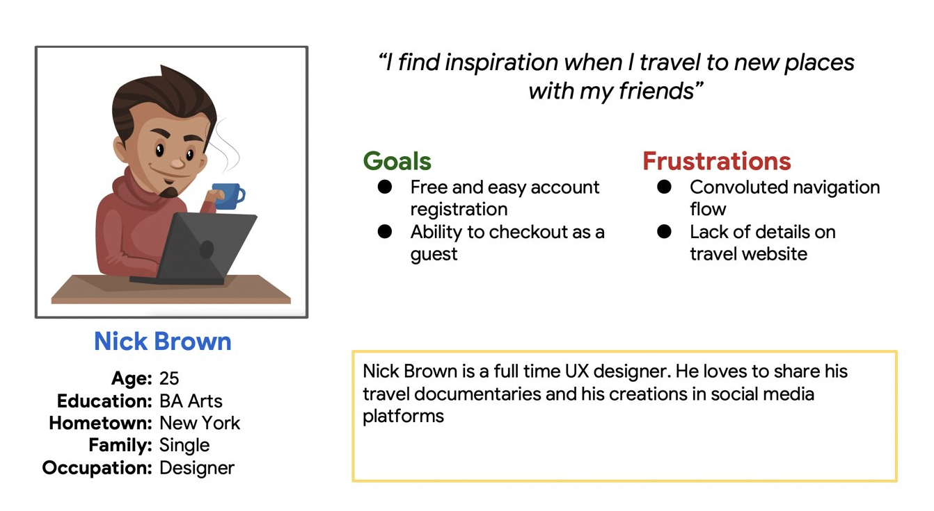
Personas 4

Slide 28
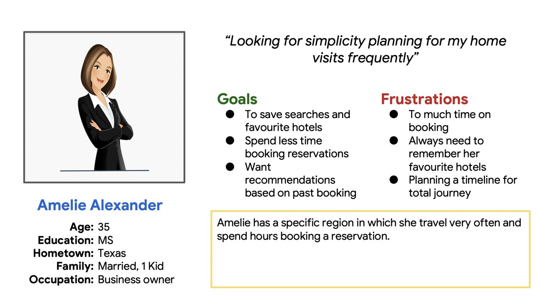
Personas 5

Slide 29
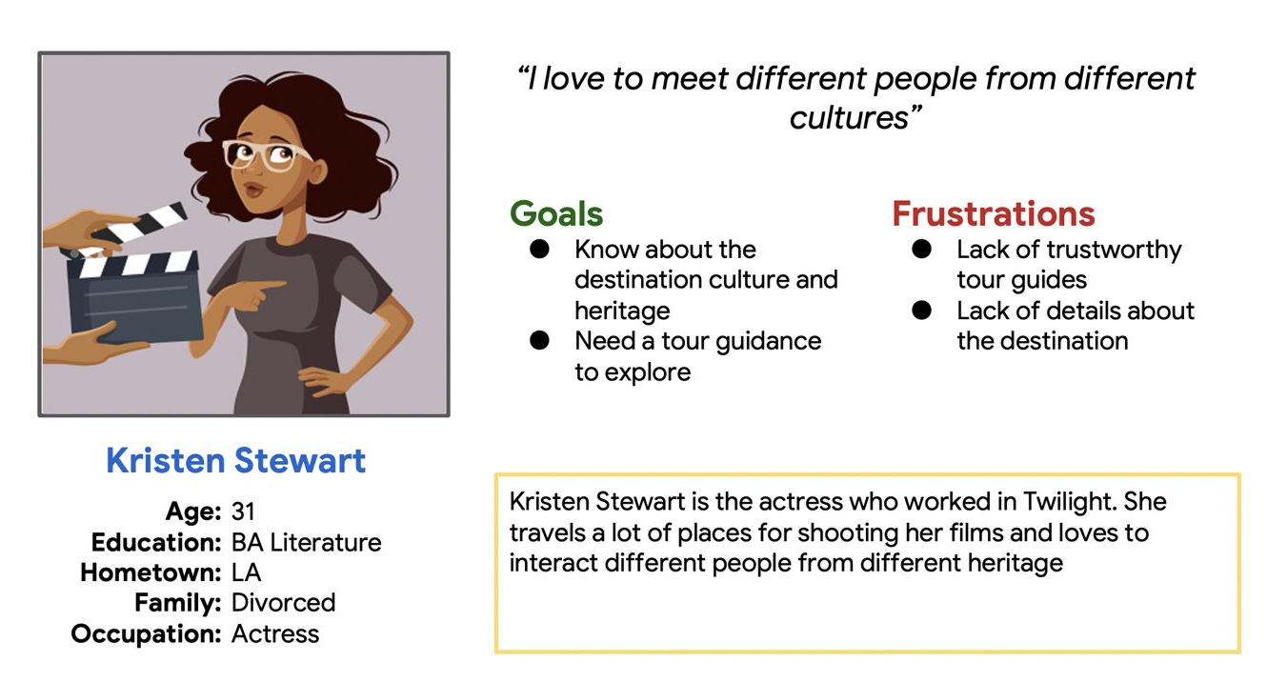
Personas 6

Slide 30
Card sorting
Help design or evaluate the Information Architecture of a site
Participants organize topics into categories that make sense to them
Participants may also help us label these groups

Slide 31
Card sorting Applied
Closed Card Sorting : Participants are asked to sort topics from content within the website into pre-defined categories. A closed card sort works best when working with a pre-defined set of categories, and we want to learn how users sort content items into each category.
Open Card Sorting : Participants are asked to organize topics from content within the website into groups that make sense to them and then name each group they created in a way that they feel accurately describes the content.

Slide 32
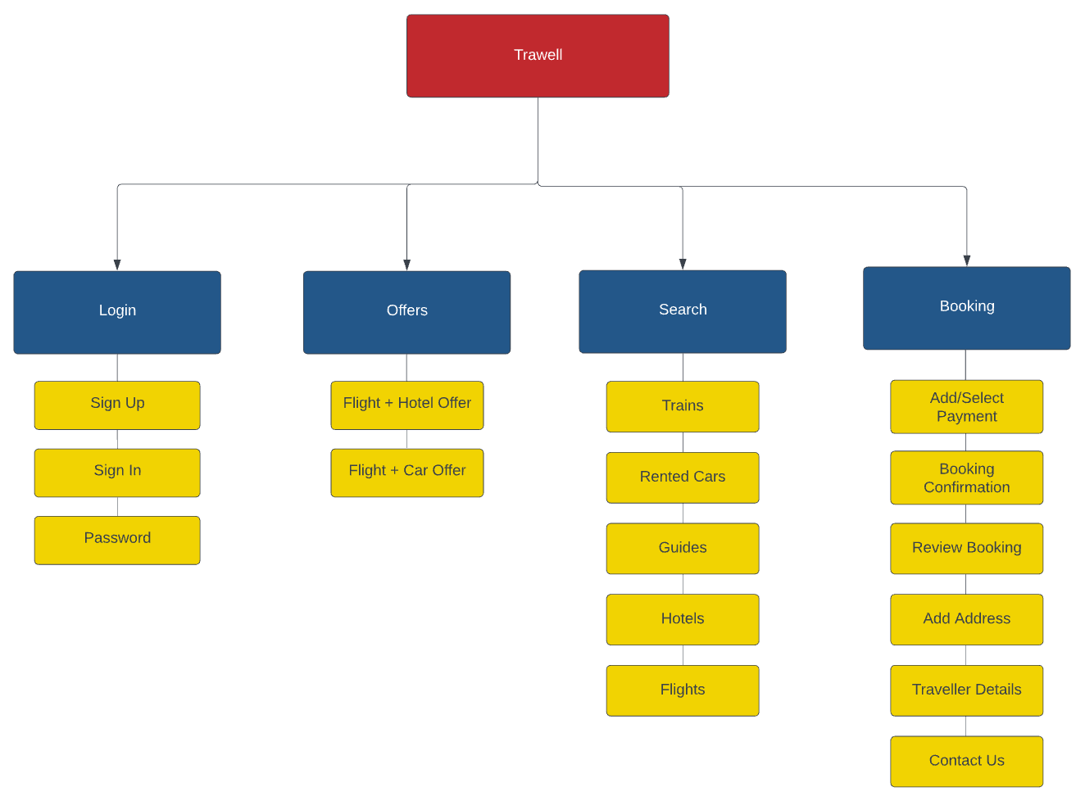
Open card sorting Information Architecture

Slide 33
Open Card sorting – Result Link
https://app.uxtweak.com/cardsort/results/SzuFDoGv2zHaaxEjU4Am9/K62nC2oPxGNodfaH5tTrw

Slide 34
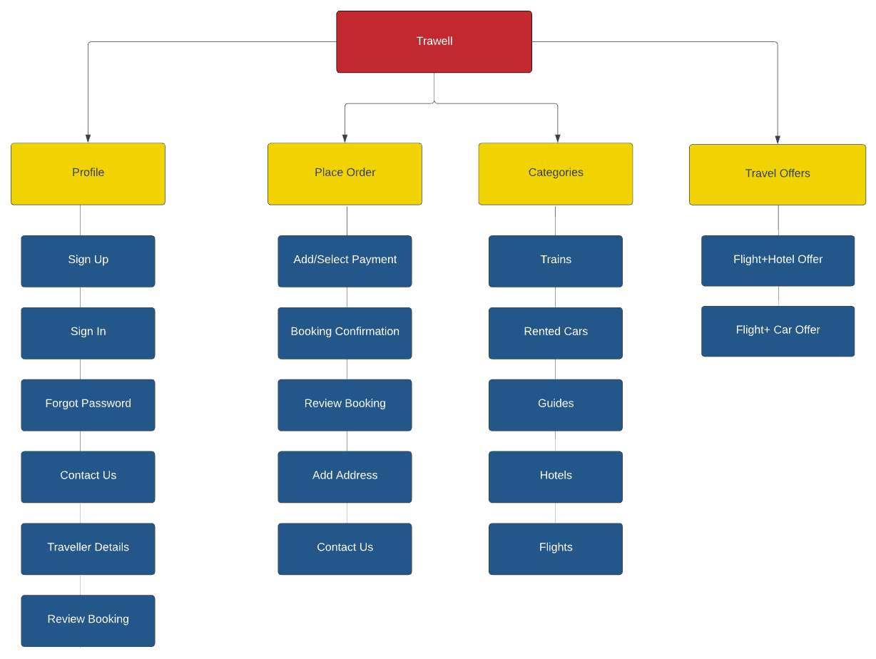
Closed card sorting Information Architecture

Slide 35
Closed Card sorting – Result Link
https://app.uxtweak.com/cardsort/results/Ss3BtpyLLtpgyk2TeKRxB/UWcsL6UOylfazyPq0Lwi7

Slide 36
Information Architecture Design Styles
We have used Bottoms up approach for designing our architecture.
We started with the creation of user personas and how those users will be going through the site
From there, we figured out how to tie it all together.

Slide 37
Error Handling
Let users know as soon as they make a mistake
Make errors prominent
Show error messages in context
Ensure messages are easy to understand and helpful

Slide 38
USABILITY TESTING
Usability testing is a research method for evaluating product with people by getting them to complete a list of tasks while observing and documenting their responses
We conducted this test to better understand how users can complete the representative tasks
We observed what users do, where they succeed and where they face difficulties with the UI

Slide 39
Usability testing Objectives
Identify
Identify length of time it takes to complete each of the tasks
Locate
Locate indirect or unintended task completion sequences (i.e. extra, unneeded steps)
Discover
Discover where users get lost in the process of completing a task
Evaluate
Evaluate visual interface
UI elements such as button and link size
Font size and type
Colors contrast between text and backgrounds
Evaluate
Evaluate navigation
Users can always return to a previous or home screen
Screen transition consistency
Simple language, terms and labels

Slide 40
Usability testing Tasks
Task #1 Create a new account Successful
Completion Criteria - Participant opens the app and completes steps required to create a new account
Task #2 Locate the navigation bar Successful
Completion Criteria - Participant opens the app and finds the navigation bar
Task #3 Locate Tours options
Successful Completion Criteria - Participant successfully finds the Tours option on the app
Task #4 Contact Customer Care
Successful Completion Criteria - Participant can successfully contact Customer Care

Slide 41
Usability testing Participants
No of Participants : 3
Age group : 20-40
Travel Lover

Slide 42
Usability testing Metrics
Task 1 | Completion | Time Taken(sec) | Error rate
Participant 1 | Yes | 30 | 0
Participant 2 | Yes | 50 | 0
Participant 3 | Yes | 45 | 0
Task 4 | Completion | Time Taken(sec) | Error rate
Participant 1 | Yes | 60 | 0
Participant 2 | Yes | 40 | 0
Participant 3 | Yes | 80 | 0

Slide 43
Usability testing Analysis
The navigation of the app was easy and intuitive for participants.
Participants mentioned that once they familiarized themselves with the app it was easier to accomplish the tasks.
Participants wish there was a splash of color to liven the app.
100% of participants mentioned that they were able to contact customer care support.

Slide 44
PLanes
Strategy Plane
Explored our Target audience, Incorporated User needs & Product Objectives
Scope Plane
We explored what features and functions are within the scope as well as what content elements may be required to meet users needs.

Slide 45
PLanes
Structure Plane
Defined the abstract structure of the product such as the arrangement of navigational elements & Information Architecture
Skeleton Plane
Defined the placement of buttons, controls, photos etc. to optimize the arrangement of these elements for maximum efficiency

Slide 46
PLanes
Developed series of pages, made up of images and text. Using this prototype users can perform some sort of function such as taking them to checkout page providing sensory experience created by the finished product.
Surface Plane

Slide 47
ONBOARDING Importance
Welcoming new customers
Onboarding equips new customers with the information they need to get started
It provides seamless experience to customers
Find overlap in must-do tasks and training opportunities
Onboarding can reduce turnover (and turnover costs)

Slide 48
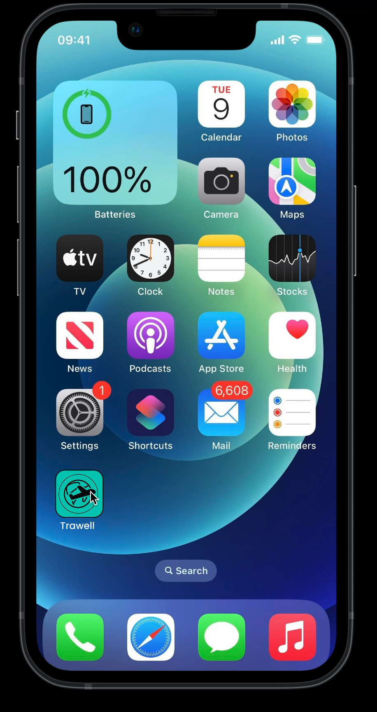
Onboarding Screen

Slide 49

Use caseS
The Link to Uses cases can be found in Appendix

Slide 50

Figma link
Figma link : https://www.figma.com/file/67h5Gf6kuziMhLcLD3vK8P/Final-Project-My-Version?node-id=0%3A1&t=P3GRq60cdKV7tzPZ-1

Slide 51
Appendix
Title | Link
Use-Case Document | Use Cases
Figma Link | https://www.figma.com/file/67h5Gf6kuziMhLcLD3vK8P/Final-Project-My-Version?node-id=0%3A1&t=P3GRq60cdKV7tzPZ-1
Closed Card Sorting Result Link | https://app.uxtweak.com/cardsort/results/Ss3BtpyLLtpgyk2TeKRxB/UWcsL6UOylfazyPq0Lwi7
Open Card Sorting Result Link | https://app.uxtweak.com/cardsort/results/SzuFDoGv2zHaaxEjU4Am9/K62nC2oPxGNodfaH5tTrw
Survey Result Link | https://app.uxtweak.com/questionnaire/results/OVE84z1LepWDkr6ibPKBw/F9l7IERilJ1fh42KVQtgh

Slide 52
References
https://maze.co/guides/concept-testing/
https://www.nngroup.com/articles/usability-testing-101/
https://www.nngroup.com/articles/which-ux-research-methods/
https://www.nngroup.com/articles/usability-101-introduction-to-usability/
https://www.nngroup.com/articles/talking-to-users/
https://www.forbes.com/sites/theyec/2018/11/30/the-importance-of-having-the-right-logo/?sh=217fdeee1ccb

